Slide 1
Mission 14 Remix
Create your own project from Mission 14

Slide 2

Warm-up
Mission 14 introduced for loops and nested for loops.
In your Mission 14 Remix Log, answer the pre-mission preparation questions:
Think back to the previous missions. Are there any that use a while loop that you can change to a for loop?

Slide 3

Time for a project remix!
A remix can be:
A new program created by adding new code to a program you already created
You can combine parts of two or more programs in a remix
Use a similar idea in a different way

Slide 4
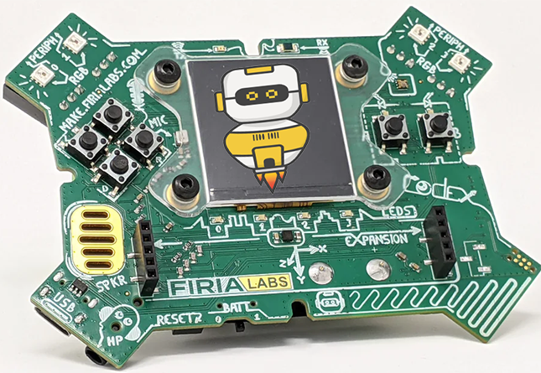
Project Remix
Creating a remix will let you:
Improve your skills and practice the concepts from the mission
Be creative
Remember code from earlier programs and missions
Work with other students
Design an original program and write the code all on your own

Slide 5
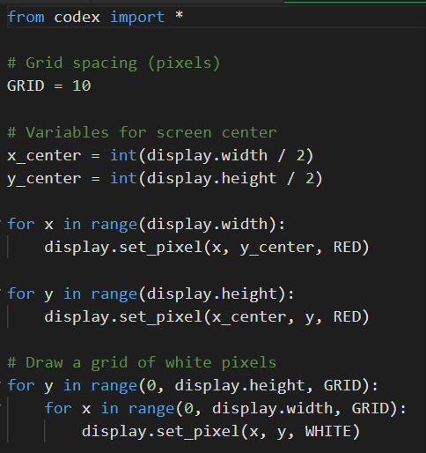
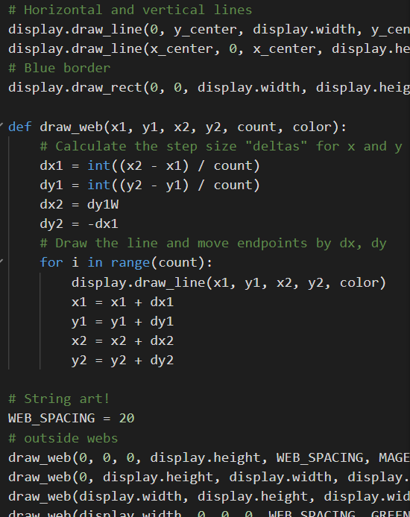
Step #1
Review the mission
Open your projects from
Mission 14
  What do the programs do?
  What skills were used or concepts learned?
DO THIS:
Fill out the information in the Mission 14 Remix Log for Step 1

Slide 6
Step #2
Brainstorm ideas
Read through remix suggestions from your teacher
Six suggestions are on the next 3 slides. You can use any of these ideas or come up with your own.

Slide 7
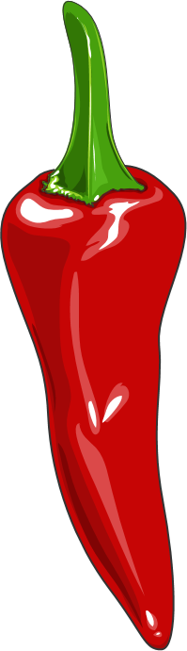
Step #2 Remix Ideas
Mild-1A
Use functions that create different webs using the “draw_web()” function. Then press buttons to display different webs.
Mild-1B
Use the CodeX graph paper to design an original small picture using circles, rectangles and lines. Use the “CodeX and Drawing Images” slides for additional help.

Slide 8
Step #2 Remix Ideas
Medium-2A
Create your own ASCII art (Bitmap image). Use the “CodeX and ASCII Art” slides or “CodeX and ASCII Art” PDF for help. Use buttons to display a Bitmap Image or a web design.
Medium-2B
Design your own image using circles, lines and rectangles (see Mild 1B). Then add x and y variables so the image can be displayed in a random position on the screen. Use the “Random Original Graphic” slides for help.

Slide 9
Step #2 Remix Ideas
Spicy-3A
Create a set of predefined envelopes like a wave, a bulge, or a twist that a user can choose from. Use button presses to display each envelope.
Spicy-3B
Use your original graphic (see Mild 1B and Medium 2B) and for loops to draw rows, columns and a grid of the original graphic. Use the “Loops with Original Graphic” slides for help.

Slide 10
Step #2
Brainstorm ideas
Read through remix suggestions from your teacher (previous slides).
Use the suggestions as presented, or combine some of the options for your own mild, medium, or spicy remix.
Use your creativity to come up with your own idea for a project.
Decide with your partner what project you will do.
DO THIS:
Fill out the information in the Mission 14 Remix Log for Step #2

Slide 11
Step #3
Make a plan
What variables will you need? What will you use them for?
What functions will you create for the program?
What for loops, graphics or sounds will you use?
What buttons will you program, and what will each button do?
DO THIS:
Fill out the information in the Mission 14 Remix Log for Step #3

Slide 12

Step #4
Code your project
IMPORTANT: In CodeSpace, go to the sandbox
Start with a new file and give it a descriptive name (Remix14)
You can leave any program open, including PixelPlay and LineArt, and use them as a guide
Import your modules
Define your variables (including tones, sounds, etc)
Write your code, testing frequently

Slide 13
Step #4
Stop and test frequently!
Don’t try to write all the code at one time
Think about the steps:
  Just get one thing to work, then move on
  Step by step!
Mistakes happen, so find them early
Type just a few lines of code and then run the program
If there is an error, fix it before continuing
Use the debugger and your other programs for help

Slide 14
Step #5
Documentation!
Make sure your code is readable by adding blank lines
Add comments to sections of your code that explain what they do

Slide 15
Step #5
Get feedback
Show your code to other students.
What do they think? Have them fill out the feedback form on your Mission 14 Remix Log.
The Mission Log has space for two people to give feedback. The feedback can come from two peers or one peer and yourself.
Modify your code to make your project even better

Slide 16

And now you have your own remix!
Congratulations!
By completing this remix you have:
learned more about programming
practiced the skills and concepts from the missions
been thinking! And problem solving and much more!

Slide 17
Mission Reflection
Wow! Great job!
Share your project with your friends!
Run projects from other students
Complete your Mission 14 Remix Log
Don’t forget to clear your CodeX by running your Clear program

